Slide 1

EE 252
Electrical Engineering Machines
UNIT 2 – DC Machines
Dr. E.K. Anto
kwakuantoh@yahoo.com//0208201565; 0243225858

Slide 2
Unit 2 – Outline of Presentation
Classification of DC Machines (separately excited, self-excited)
DC Generators
Voltage equation of DC generator
Armature reaction
Load characteristics
Shunt generators & its load characteristics
Series generators & its load characteristics
DC Motors
Back emf and its significance
Voltage equation of DC motor
Speed and torque of DC motor
Shunt motor & its speed-torque characteristics
Series motor & its speed-torque characteristics
Speed control of DC motors

Slide 3
2.1: Introduction
A DC machine is an alternating current (AC) machine, but furnished with a commutator, which under certain conditions converts AC to DC.
CLASSIFICATION OF DC MACHINES
Separately Excited Machines –
the field winding is connected to a source of supply other than the armature of its own machine
(2) Self-Excited Machines , which may be subdivided into
Shunt machines – the field winding is connected across or in parallel with the armature windings
Series machines – the field windings are connected in series with the armature winding
Compound machines – a combination of shunt and series windings
(NOTE: The compound machine will NOT be treated in this course)

Slide 4
2.2: Separated Excited Machines
In separated excited machines, the field winding is connected to a source of supply other than the armature of its own machine

Slide 5
2.3: Self-Excited Machines
There are three types of self-excited DC machines, namely, shunt, series and compound machines;
Each differs from the other in the mode of connection of the field coils to the armature winding

Slide 6
2.4: DC Generators – Constructional Features and Types
A modern 4-pole DC generator with the main parts named is shown below.
The flux produced by the field windings of a generator is established in the field yoke, pole cores, air gap and armature core , all of which form what is known as the magnetic circuit.

Slide 7
2.4: DC Generators – Constructional Features and Types (2)
The electric circuits of a DC generator are made up of the armature winding, commutator, brushes and field windings.
Most generators are equipped with small poles called interpoles or commutating poles, which are placed midway between main poles
Flux is established in these inter-poles only when current flows in the armature circuit, the purpose of the commutating flux being to improve commutation
The term armature is generally associated with the rotating part (windings) of the DC machine, and it is the place where the voltage is collected.

Slide 8
2.4.1: Voltage Equation of DC Generator
The generated voltage or emf is induced in the armature winding of the generator.
Let
= number of poles
= useful flux per pole in Webers(Wb), entering or leaving the armature
= total number of conductors on armature = number of slots x number of conductors per slot
= rotational speed of armature in revolutions per minute (r.p.m.)
= number of parallel paths in armature, depending on type of armature winding (Lap or Wave)
= generated emf per parallel path in armature.

Slide 9
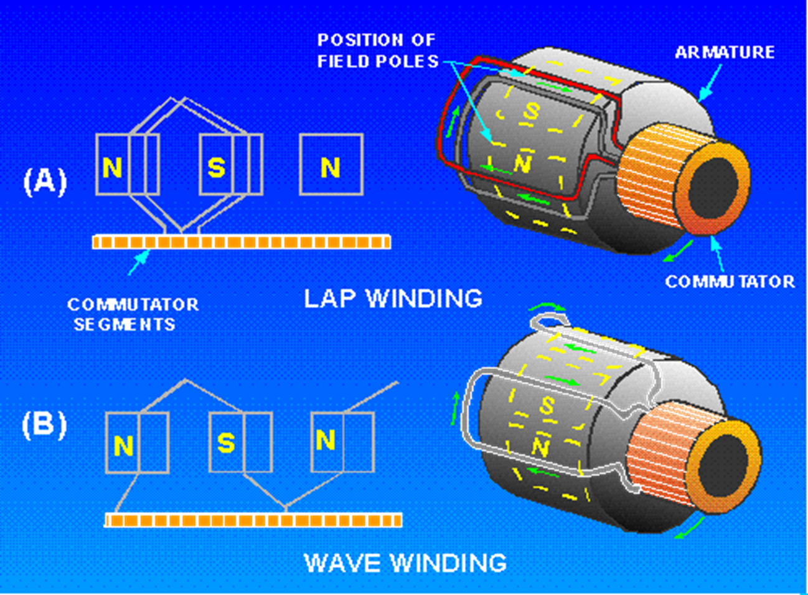
2.4.1: Voltage Equation of DC Generator (2)
In general, the generated voltage is given as:
Where
for Lap winding
for Wave Winding
Therefore

Slide 10
Example 2.1
A 60-kW four pole generator has a lap winding placed in 48 armature slots, each slot containing six conductors. The pole flux is 0.08 Wb and the speed of rotation is 1040 rpm.
(a) Determine the generated voltage
(b) What is the current flowing in the armature conductors when the generator delivers full load?

Slide 11
Solution 2.1
(a) The total number of conductors is Z = 48 x 6 = 288. For lap winding, the number of parallel paths in the armature circuit equals the number of poles, that is, b = 4.
Thus the generated emf is
(b) The output current of the generator is:
Since there are four parallel paths, each path must supply 150 ÷ 4 = 37.5 A. Therefore conductor current is 37.5 A.

Slide 12
2.4.2: Armature Reaction in Generators
When the armature is connected to a load and delivers current, the armature current produces opposing armature flux that interacts with the main field flux.
By armature reaction is thus meant the influence or distorting effect of the magnetic field set up by the reactionary armature current flux (when armature is on-load and delivering current) on the value and distribution of the main field flux in the air gaps between poles and on the stator core.
The armature reaction in a generator has two main effects:
It demagnetises or weakens the main flux
It cross-magnetises the poles.
The first effect leads to reduction in the generated voltage, whilst the second effect leads to sparking at the brushes

Slide 13
2.4.3: Compensating Windings in Generators
The cross-magnetising effect of the armature reaction in a generator may be neutralised by means of compensating windings embedded in the pole faces of the generator.
These pole-face compensating windings are connected in series with the armature so as to carry the same current as the armature.
Compensating windings find greatest application in high speed and high voltage DC machines of large capacity and which are subject to large fluctuations in load.

Slide 14


2.4.4: Load Characteristics of DC Generators
The properties of generators are analysed with the aid of characteristics which give the relations between fundamental quantities determining the operation of a generator.
These include the voltage across the generator terminals, the field current, the armature current and the speed .
The three most important steady-state characteristics of DC generators are:
(1) No-Load Saturation Characteristics ( )
(2) Internal Characteristics ( )
(3) External (load) Characteristics ( )

Slide 15
2.4.4.1: No-Load Characteristics ( ) of Separately Excited Generators
The separately-excited generator is supplied field excitation from an external independent DC.
The no-load characteristic is also known as the generator magnetisation curve or open-circuit characteristics (OCC)
They show the relationship between the no-load generated emf in armature and the field or exciting current at a given constant speed

Slide 16

2.4.4.2: Load Characteristics ( ) of Separately Excited Generators
This characteristic is sometimes referred to as performance characteristic or voltage regulation curve.
It gives the relationship between the terminal voltage and the load current.
The load-characteristic of the separately-excited generator is shown below

Slide 17
2.4.4.2: Load Characteristics ( ) of Separately Excited Generators (2)
When a separately excited generator is operated at a constant speed and with a constant field excitation is unloaded, the terminal voltage will be equal to the generated voltage.
But when it is loaded and delivering current, the terminal voltage will be less than the generated voltage because of:
(1) Armature-reaction drop: Armature currents establish an mmf that distorts and weaken the main field flux, especially in non-interpole machines, an effect know as armature reaction
(2) IR-resistance drop of the armature winding and brushes
The armature reaction drop is normally compensated with the compensating windings.
Thus the terminal voltage is given as:

Slide 18
Example 2.2
A separately excited generator has a generated voltage of 200 V at a speed of 1200 rpm with a field of 2.5 A.
Calculate:
(a) Generated voltage at 1600 rpm with a field current of 2.5 A
(b) Generated voltage at 1000 rpm with a field current of 3.0 A

Slide 19
Solution 2.2
The generated voltage is given as , where is a constant which varies from one machine to another.
Assuming that flux is a function of field current, that is, ,
Then in place of the flux, we can substitute the field current.
Hence, , and using proportionalities:
(a)
(b)

Slide 20
2.4.5: Applications of Separately Excited Generators
Separately excited generators are more expensive than self-excited generators as they require a separate source of supply.
Separately excited generators are also used where quick and requisite response to control is important, since separate excitation gives a quicker and more precise response to the changes in the resistance of the field circuit.
They are also used for experiments/research in the labs

Slide 21
2.4.6: Shunt Generators – Load Characteristics
The shunt generator is a self-excited generator whose field circuit is connected directly across or in parallel with the armature
Load Characteristic of a Shunt Generator

Slide 22
2.4.6.1: Shunt Generators – Factors accounting for decreased terminal voltage
Three main factors account for the higher rate of decrease in terminal voltage of the shunt generator. These are
Armature reaction
Armature circuit resistance drop
Reduction in field current
Armature reaction and IR-drop in the armature circuit cause the terminal voltage to decrease.
The external load-voltage characteristic decreases with application of load only to a small extent up to its rated load (current) value.
The shunt generator is considered as having fairly constant output voltage with application of load

Slide 23
2.4.6.2: Shunt Generators – Applications
The shunt generator may be used for supplying excitation to AC generators or in other applications where the distance from the generator to its load is short.
It is also used for charging storage batteries.

Slide 24
2.4.6.2: Shunt Generators – Important Governing Equations of Shunt Generator
Where
= shunt field current
= armature current
= load current
= shunt field resistance
= armature resistance
= generated emf
= terminal voltage

Slide 25
Example 2.3
A DC shunt generator delivers a current of 96 A at 240 V to a resistance load. The resistance of the armature is 0.15 Ω and the field resistance is 60 Ω. Assuming a brush drop of 2 V, calculate the
(a)current in the armature
(b)generated emf

Slide 26
Solution 2.3
The field current is obtained as
Hence the armature current is:
(b)The generated voltage is:

Slide 27
2.4.7: Series Generators – Load Characteristics
The series generator is a self-excited generator with armature, field windings and load all connected in series.
Load characteristics of Series Generators

Slide 28
2.4.7: Series Generators – Load Characteristics (2)
When the series generator is running without load, there is a small emf generated owing to the residual magnetism.
As an external load is applied and more current begins to flow, the terminal voltage of the generator is increased.
This rise in terminal voltage is due to the fact that the armature current flows in the field coil and more armature current means more flux and hence a higher generated emf.
The terminal voltage continues to increase until the magnetic circuit becomes saturated.

Slide 29
2.4.7: Series Generators – Load Characteristics (3)
The load characteristic curve is similar in shape to the saturation curve, but lies below the saturation curve for the following two reasons:
The flux per pole is reduced due to armature reaction, which in turn causes a reduction in the generated voltage and
The resistance drop of the armature winding, field winding and brushes.

Slide 30
2.4.7.1: Series Generators – Applications
This type of characteristic of the series generator is rather unstable which limits the use of series generators.
Due to the initial rising voltage characteristic, the series generator is suitable for applications where voltage boosting is required to give an increase of voltage practically proportional to the current.
For special purposes, such as supplying the field current for regenerative braking of DC locomotives

Slide 31
2.4.7.2: Shunt Generators – Important Governing Equations of Shunt Generator
Where
= series field current
= armature current
= load current
= series field resistance
= armature resistance
= generated emf
= terminal voltage

Slide 32
2.5: DC Motors - Constructional Features and Types
Motors are classified into two broad groups, depending on whether they are suitable for use on direct-current or alternating current systems.
They are
DC and AC motors.
Universal Motor which can be used on DC or AC supply.
More AC motors are, however, in use than DC motors, and this is due to two factors:
The majority of our supply systems are AC.
The AC motor is simpler and cheaper than its DC counterparts

Slide 33
2.5.1: Back emf in DC Motors
A motor experiences generator effect when the supply voltage is applied across the armature via the split-rings or commutator, and current flows in the armature windings.
According to Fleming’s Left-Hand Rule, the current-carrying armature windings in the presence of the stator magnetic field will experience either an upward or a downward force, depending on the direction of the current and field polarity.
On moving vertically upward or downward, the armature windings will cut the magnetic flux of the field coils.
And so in accordance with Faraday’s Laws of Electromagnetic Induction, an emf will be induced in the armature conductors cutting the field flux.
This effect is called generator effect in a motor action.

Slide 34
2.5.1: Back emf in DC Motors (2)
The direction of the induced emf is determined by Fleming’s Right-Hand Rule, and is found to be in the opposite direction to the impressed supply voltage.
This induced emf always opposes/counteracts the applied voltage, and is thus called the counter or back emf
The back emf is directly proportional to the armature speed and the field strength B, and the same in value as the generated voltage in the armature windings of a generator.
Thus,

Slide 35
2.5.1: Back emf in DC Motors (3)
The effective voltage across the motor armature thus equals the applied voltage minus the induced counter voltage (or back emf) .
If an armature has ohms resistance , the current flowing through it can be determined by the equation:

Slide 36

2.5.2: Significance of Back emf
The back emf depends, among others, on the armature rotational speed.
If the speed is high, then is large and hence the armature current is small.
If the speed is less, then is also less, and hence more current flows which develops motor torque.
The back emf acts like a governor, that is, it makes a motor self-regulating so that it draws as much current as is just necessary.

Slide 37
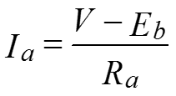
2.5.3: Voltage equation of a DC motor
Recall the equation of the current flowing through the armature, in relation to the back emf;
From this equation, the fundamental voltage equation of the motor is obtained as:
The voltage is thus applied to overcome the back emf and also supply the armature ohmic drop

Slide 38
Example 2.4 & Solution 2.4
The armature of a DC machine has a resistance of 0.1 Ω and is connected to a 250 V supply. Calculate the generated voltage when it is running
(a) as a generator giving 80 A
(b) as a motor taking 60 A
SOLUTION 2.4
(a) Voltage drop due to the armature resistance = 80 x 0.1 = 8 V.
Thus as generator, the generated voltage is
(b) Voltage drop due to armature resistance = 60 x 0.1 = 6 V.
Thus as motor, the generated voltage is

Slide 39
2.5.4: Power relationships and torque equations in DC Motor
If each term of the fundamental motor equation is multiplied by the armature current, the resulting equation is
The term represents the electrical power supplied to the armature of the motor;
The term represents the power lost as heat due to armature resistance.
The remainder of the power, , must therefore be the electrical equivalent of mechanical power developed within the armature.
The remainder of the power, after subtracting these losses, appears as power available at the shaft for driving the external load.

Slide 40
2.5.4: Power relationships and torque equations in DC Motor (2)
In practice, it is sufficiently accurate to assume that the power supplied by the shaft is .
The motor efficiency is given by the ratio of power developed by the armature to its input, that is,
If is the torque (in Nm) is the torque developed within the armature of a motor that running at N revolutions per sec (r.p.s.), then the power developed is given by the relation:
But the electrical power converted into mechanical power in the armature is given by
Hence equating the two equations, we obtain

Slide 41
2.5.4: Power relationships and torque equations in DC Motor (3)
Substituting the value of the back emf , the armature torque is given as:
Since P, b and Z are constants, the torque equation can be rewritten as: where is a constant.
In other words, the torque developed within the armature is directly proportional to the flux per pole and to the armature current, but the developed torque is independent of the speed.
Recall a similar relation for a generator,

Slide 42
2.5.5: Speed of DC Motor
An equation suitable for investigating the speed variation in a motor may be obtained by substituting the expression for the back emf
Solving for the speed, we obtain:
The armature drop is usually less than 5% of the terminal voltage,
And so the speed can be approximated as:

Slide 43
Example 2.5 & Solution 2.5
A motor runs at 900 rpm on a 460 V supply. If the machine is connected across a 200 V supply, calculate the new speed. Assume the new flux to be 0.7 times the original flux
SOLUTION 2.5
We make use of the speed equation,
And so the relationship between the old speed (conforming to situation with subscript 1) and the new speed (conforming to a new situation with subscript 2) is given as

Slide 44
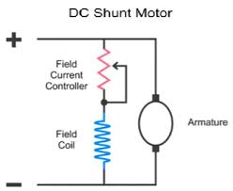
2.5.6: Shunt Motors
Shunt motors are connected in the same way as the shunt generator, that is, with the shunt field directly across the terminals in parallel with the armature circuit.
A field rheostat is usually connected in series with the shunt field.
Diagram of Shunt Motor

Slide 45
2.5.6: Shunt Motors (2)
Since the line voltage is assumed constant, the field current and field flux are constant.
For a shunt motor, the supply voltage is the current source, and so input or line current is related to the shunt (field) current and the armature current as follows:
Recall that for shunt generator, the current source is the armature, and hence

Slide 46
2.5.6.1: Speed considerations of Shunt Motors
SPEED CONSIDERATIONS
A shunt motor has good speed regulation and is classed as a constant-speed motor, even though its speed does increase slightly with an increase in load.
In a shunt motor, the applied voltage , armature resistance, and flux per pole are practically constant, and the armature current is the only variable.
When a motor is carrying no load, the value of the armature current is small, because the speed and therefore the back emf are both at a maximum.

Slide 47
2.5.6.2: Torque considerations of Shunt Motors
TORQUE CONSIDERATIONS
The relation between the torque developed by a shunt motor and the current flowing through its armature winding may be analysed easily by referring to the general torque equation
For a shunt motor, the field flux is practically constant
The torque of the shunt motor will thus vary directly linearly with the armature current, as in the equation below.

Slide 48
2.5.6.3: Speed-torque characteristics of Shunt Motors
Speed-torque characteristics of Shunt Motor
The torque increases in a practically straight-line relationship with an increase in armature current
The speed, however, drops slightly as the armature current is increased.

Slide 49
2.5.6.3: Speed-torque characteristics of Shunt Motors (2)
The fall in speed is reduced slightly by the armature reaction, which causes the flux to be less and the speed to increase correspondingly.
For these reasons, a shunt motor is considered a near constant speed motor,
Even though the speed usually decreases slightly with an increase in the load.

Slide 50
2.5.6.4: Applications of Shunt Motors
Since there is no appreciable change is speed of a shunt DC motor from no-load to full-load, it may be connected to loads which are totally and suddenly thrown off without any fear of excessive speed resulting.
Due to the near constancy of their speed, shunt motors are best suited for constant speed drives.
It meets the requirements for a large range of industrial applications, such as the driving of machine tools, blowers, fans, and line shaft, lathes, wood-working machines and for all other purposes where an approximately constant speed is required.

Slide 51
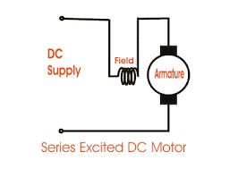
2.5.7: Series Motors
The field windings are connected in series with the armature, the input or line current is related to the field current and armature current in a series DC machine as follows:
Diagram of Series Motor

Slide 52
2.5.7.1: Speed considerations of Series Motors
SPEED CONSIDERATIONS
The fundamental motor speed equation may also be applied to a series motor, where is considered to include the resistance of the series winding.
Thus modifying the value of the armature circuit resistance into to reflect the total resistance in the armature circuit, that is, the sum of the armature resistance and the series field winding resistance, we obtain the speed equation for a series motor.
Thus the speed equation of the series motor becomes:
Where

Slide 53
2.5.7.1: Speed considerations of Series Motors (2)
In a series motor, the flux increases almost directly with the load.
It follows that the series motor speed decreases very appreciably with increase in load, as can be seen from the equation:
The speed of a series motor depends almost entirely on the flux in an inverse proportionality
That is, the stronger the field flux, the lower the speed and vice versa.

Slide 54
2.5.7.2: Torque considerations of Series Motors
TORQUE CONSIDERATIONS
From , the torque developed by any DC motor varies with flux and armature current
However, in a series motor, the same current passes through the armature and the field.
Therefore up to the point of magnetic saturation, the flux will be almost directly proportional to the armature current, that is, ,
And therefore the torque is directly proportional to the square of the armature current
Thus

Slide 55
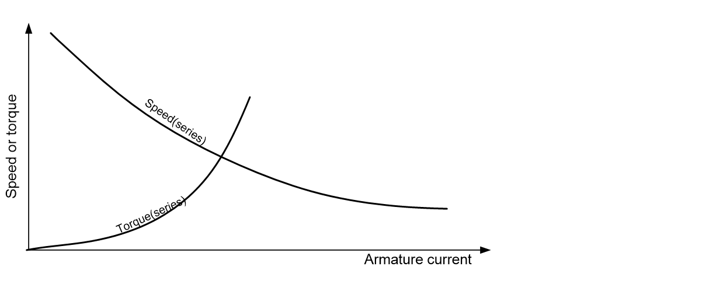
2.5.7.3: Speed-torque characteristics of Series Motors
At light loads, the armature current and hence the flux is small.
But as increases, the torque also increases as the square of the current.
That is, when the armature current doubles, the torque becomes four times as great
Speed-torque characteristics of Series Motor

Slide 56
2.5.7.4: Applications of Series Motors
A drop in speed with increased load is much more prominent in series motors than in shunt motors.
Hence series motors are not suitable for applications requiring constant speed.
Series motors are used chiefly for widely varying loads, where extreme speed changes are not objectionable.
Because a series motor exerts a torque proportional to the square of the armature current, they are used in situations where high starting torque is required for accelerating heavy masses quickly as in hoists, cranes, and traction purposes (electric trains).
In addition to the huge starting torque, there is another unique characteristic of series motors, which makes them especially desirable for traction work.

Slide 57
Example 2.6 & Solution 2.6
A 125 V shunt motor has an armature circuit resistance of 0.2 Ω and a shunt field resistance of 45 Ω. If the line current is 50 A, calculate the
(a) generated voltage (back emf)
(b) developed power
SOLUTION 2.6
The field current is given as:
For the motor, the armature current is given as
The generated voltage (back emf) is
The developed power is

Slide 58
2.5.8: Speed Control of DC Motors
The speed of a motor varying with the field excitation, provides a convenient means for controlling the speed of a DC motor.
The field current and the field flux may be varied by a field rheostat.
Increasing resistance in the field circuit causes a decrease in the field flux and, therefore, an increase in speed.
Likewise, a decrease in resistance causes a decrease in speed.
If a motor is able to maintain a nearly constant speed for varying loads, the motor is said to have a good speed regulation.

Slide 59

2.5.8: Speed Control of DC Motors (2) – Methods
The speed of the DC motor can be controlled in the following three ways by varying:
Armature resistance i.e., Armature resistance control (use of a resistor termed controller in series with the armature)
Field flux per pole i.e., Field flux control (use of variable resistor termed field regulator, in series with the shunt winding)
Applied voltage i.e., Voltage control (use of thyristors fired at appropriate times or angles in power electronic circuits)

Slide 60
Example 2.7
A 600 V shunt motor has an armature resistance of 0.14 Ω. At no-load, when running at 800 rpm, the armature current is 12 A. The full-load armature current is 225 A. Calculate the full-load speed when the filed pole flux is
(a) constant
(b) reduced to 95 % of its original value by armature reaction
(c) reduced to 85 % of its original value by adjusting the field current

Slide 61
Solution 2.7
At no-load, the generated voltage (back emf) is obtained from the general motor voltage equation
At full-load, the generated voltage (back emf) is obtained from the general motor voltage equation
(a) Since the flux is constant, the speed is proportional to the generated voltage.

Slide 62
Solution 2.7 (2)
(b) When the field pole flux has been reduced to 95%,
(c) When the field pole flux has been reduced to 80%,

Slide 63
2.6: Exercises
(1) A four-pole armature is wound with 564 conductors and driven at 800 rpm, the flux per pole being 20 mWb. Calculate the emf generated in the armature if the conductors are connected (a) wave (b) lap.
(2) An eight-pole lap-connected armature has 96 slots with 6 conductors per slot, and is driven at 500 rpm. The useful flux per pole is 0.09 Wb. Calculate the generated emf.
(3) Give TWO applications EACH of a shunt and series generator. A four-pole armature has 624 lap-connected conductors and is driven at 1200 rpm. Calculate the useful flux per pole required to generate an emf of 250 V.
(4) A six-pole armature has 410 wave-connected conductors. The useful flux per pole is 0.025 Wb. Find the speed at which the armature must be driven if the generated emf is to be 485V.

Slide 64
2.6: Exercises (2)
(5) A 6-pole 240 V shunt generator with a wave-wound armature having 140 slots, each slot containing 8 conductors, supplies ten 4 kW resistive loads. Allowing a voltage drop of 15 V in the connection leads between the generator and the load, calculate the speed at which the generator must be driven. Assume a brush drop of 1.5 V. The armature and field resistance are respectively 0.025 Ω and 51 Ω. Take the flux per pole as 40 mWb.
(6) The armature of a DC machine has a resistance of 0.25 Ω and is connected to a 300 V supply. Calculate the e.m.f. generated when it is running:
(i) as generator supplying 100 A load
(ii) as a motor taking 80 A current

Slide 65
2.6: Exercises (3)
(7) An eight pole 1250 rpm lap-wound motor has 140 slots in its armature, each slot containing 6 conductors, and draws an armature current of 60 A from a 250 V DC supply. If the resistance of the armature circuit is 0.15 Ω, calculate the following:
(i) useful flux per pole
(ii) gross torque developed by the armature.
(8) A 4-pole motor has its armature lap-wound with 130 slots, each slot containing 8 conductors, and runs at 1000 rpm when taking an armature current of 50 A from a 250 V DC supply. If the resistance of the armature circuit is 0.2 Ω, calculate the following:
(i) useful flux per pole
(ii) gross torque developed by the armature.

Slide 66

Thank You – End of Unit 2
For any concerns, please contact
elearning@knust.edu.gh
elearningknust@gmail.com
0322 191132

